Slide 1

COVID-19 DATA ANALYTICS AND FORECASTING
Proud Cockroaches

Slide 2
Abstract
This project gives an overview of the most recent pandemic of the novel coronavirus 2019 (COVID-19) and shows how data analysis of such an epidemic plays an important role for further predictions and even predictions of future situations.
Key words: COVID-19, data analysis, forecasting model

Slide 3

Team members
Hang Le Thi Thuy
Vinh Nguyen Do Phu
Dai Nguyen Quoc
Nghiep Nguyen Le Tan
An Bui Pham Thai

Slide 4

Introduction
The key to understanding the pandemic begins with understanding the disease itself and how the disease progresses naturally. This report presents different categories of diseases and different routes of disease transmission. Various past pandemics and stages of the pandemics are also discussed.
Accurately predicting the rate of spread and infection can help minimize the outbreak by taking precautionary measures. However, forecasting requires data and there are various data processing challenges. The main aim is to show how machine learning techniques can be useful for data analysis, essentially in the context of the recent COVID-19 pandemic

Slide 5
TAKS
Data collection
Data analysis
Collect data on the disease situations around the world.
1
2
Provide analysis and developments.
Model prediction
Model analysis
Predict the epidemic situation in the next 1 week – 3 months
3
4
~~~???~~~

Slide 6

01
Epidemiology terms and concept

Slide 7
1.1 - Concept of a disease
Diseases are mainly categorized into two types
Type of disease
Genetic disease, exists since birth
Spread through organism, not hereditary
Congenital
Acquired
Non-infectious
Infectious
Spread by germs or viruses between living objects
Ex: SARS and SARS COVID-19
Cannot be spread
Ex: cancer and autoimmune disorders

Slide 8


1.1 - Concept of a disease (cont.)
Infectious disease can affect a healthy person in two ways
Direct transmission
Indirect transmission
Middle agent
Contact with the infected
Droplet infection
Contact with the soil
Animal bites
Vehicle-borne
Air-borne
Fomite-borne

Slide 9



1.1 - Concept of a disease (cont.)
After diagnosis, we need treatment.
There are two ways to stop the disease from spreading further
Treatment
Prevention
Cure
Relieve pain using painkillers
Vaccination
Using drugs or chemical to kill the pathogen

Slide 10
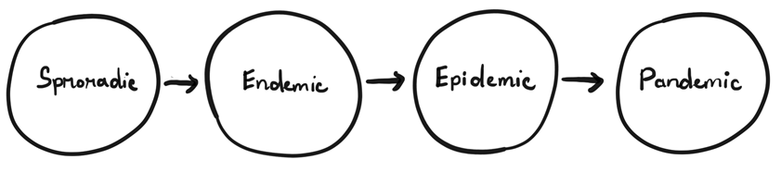
1.2 - Overview of epidemics
Progress of a disease
When the occurrence of the disease is not regular and is infrequent, it is termed as sporadic.
When the presence of the disease is constant in a particular geographical area, it is known as endemic. Endemic turns into a hyperendemic situation when a high level of disease occurrence is observed.
When there is a sudden rise in the number of patients with the same disease and within a particular area, it is termed as an epidemic.
When epidemics affect larger geographical areas (including multiple countries and continents), it is known as a pandemic.

Slide 11
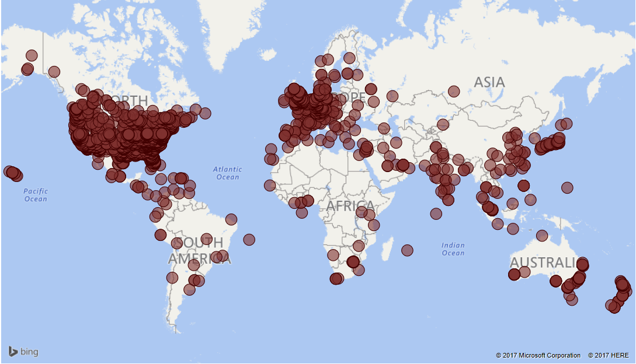
1.2 - Overview of epidemics (cont.)
When the epidemic crosses local boundaries and at the same time affects a large geological area, it becomes a pandemic.

Slide 12
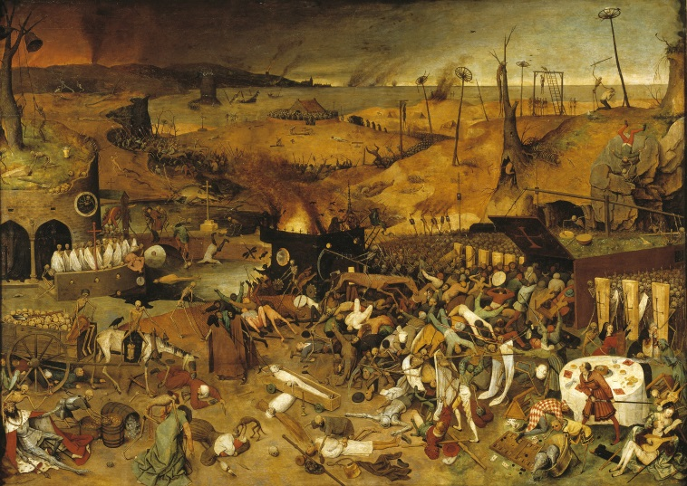
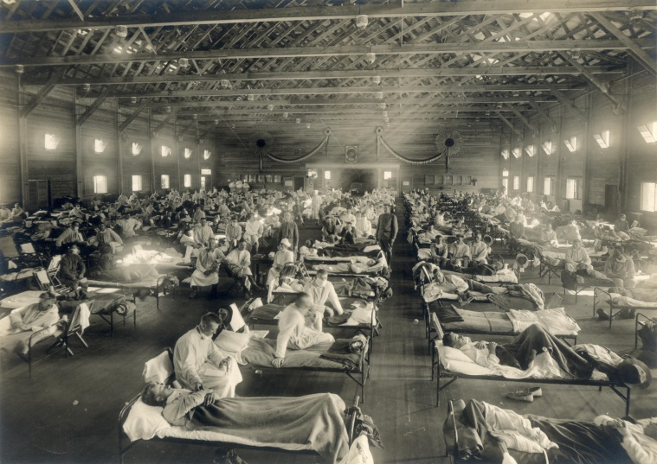
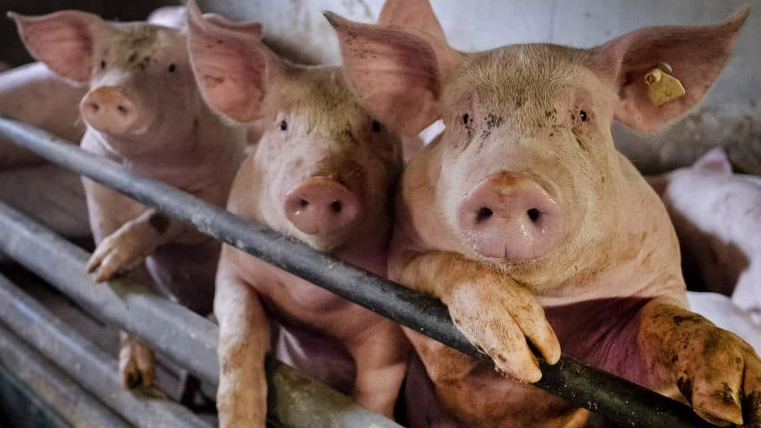
1.2 - Overview of epidemics (cont.)
Some pandemics stand out in history because of the catastrophe they have caused.
Historical records indicate that these pandemics pose a serious threat to humanity.
Black Death pandemic (1347)
Spanish flu influenza (1918)
Swine flu influenza a.k.a H1N1 (2009)

Slide 13

1.2 - Overview of epidemics (cont.)
The latest pandemic is the Coronavirus Disease 2019 (COVID-19), declared a pandemic by the World Health Organization (WHO) in January 2020.

Slide 14

1.3 - The novel coronavirus
The word “novel” means “unknown” or “dealing with something new”.
From the beginning of the outbreak, extensive efforts are being demonstrated by scientists and experts all over the world.

Slide 15


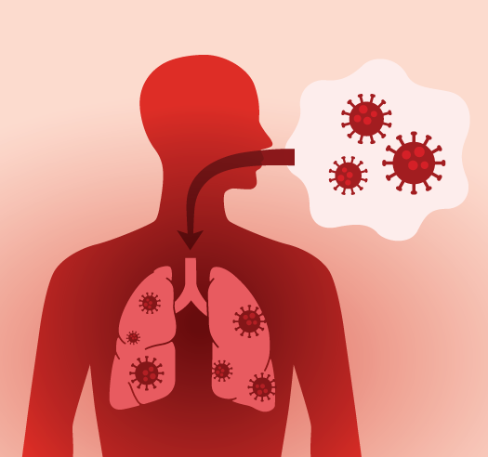

1.3 - The novel coronavirus (cont.)
COVID-19 has a zoonotic origin (transmitted from animals to humans).
Can spread through air droplets.
Wide range of symptoms: from asymptomatic to severe pneumonia.

Slide 16

1.3 - The novel coronavirus (cont.)
The COVID-19 outbreak was an unprecedented situation that no one saw coming. Professionals and experts from different disciplines have to work together to find a solution.

Slide 17
02
Exploratory data analysis

Slide 18
This project focuses on analyzing data from July 1, 2020 to May 31, 2021 of three groups:
(i) Global
(ii) Three countries with highest confirmed cases: United States, Brazil, India
(iii) Three Asian countries: Japan, Korea, Vietnam

Slide 19
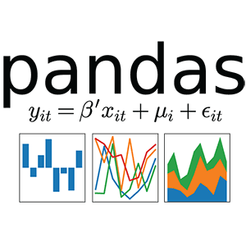
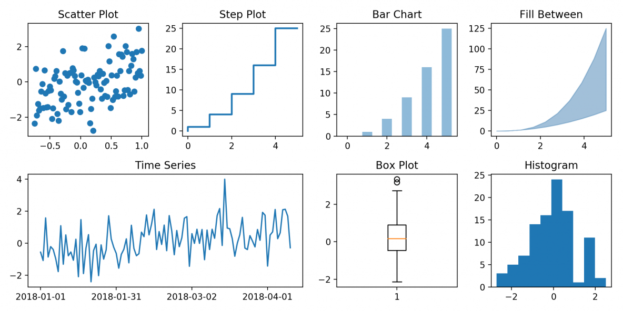
2.1 - Data retrieve
Start by importing the necessary libraries.
We mainly use Pandas for retrieving, storing and manipulating data.
For visualization, we use Matplotlib and Seaborn.

